Slide 1
Machine Independent Assembler Features
Literal, Symbol, Expression

Slide 2
Literals
Motivation
  It is convenient if a programmer can write the value of a constant operand as a part of the instruction that uses it.
  This avoids having to define the constant elsewhere in the program and make up a label for it.
Such an operand is called a literal because the value is stated literally in the instruction.

Slide 3
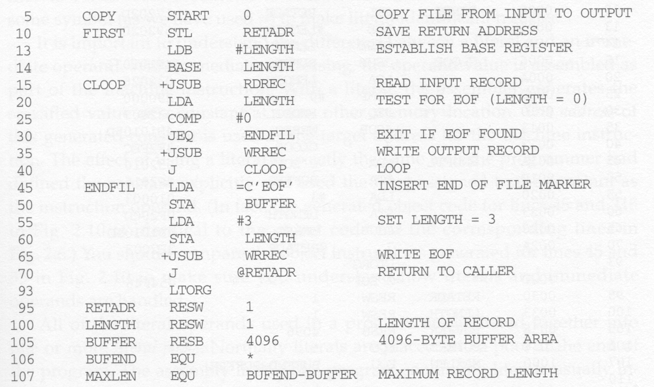
Literal Example (1)
Use = to represent a literal

Slide 4
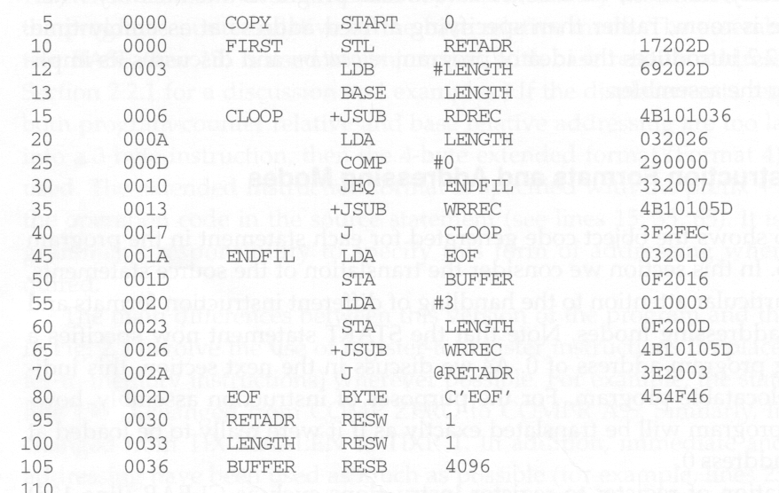
Original Program (1)

Slide 5
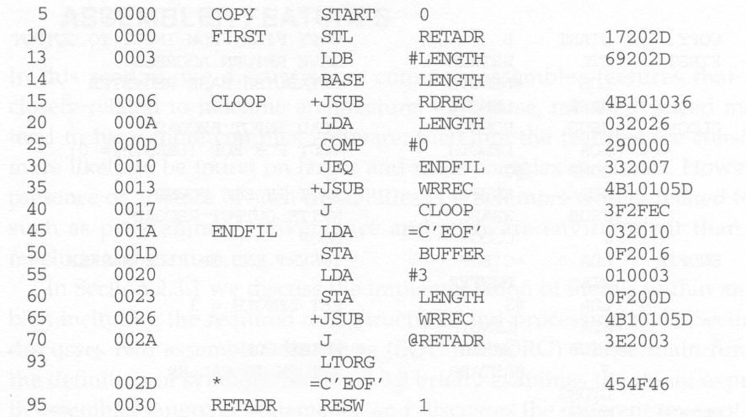
Literal Program (1)’s Object Code
Notice that the object code is the same as the previous one.

Slide 6
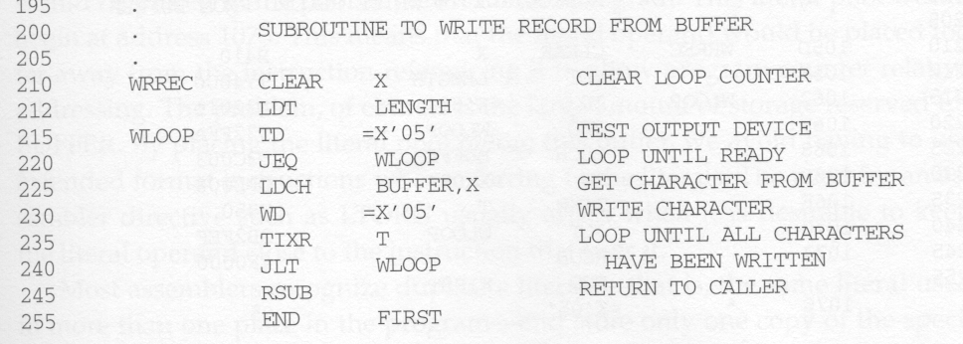
Literal Example (2)

Slide 7
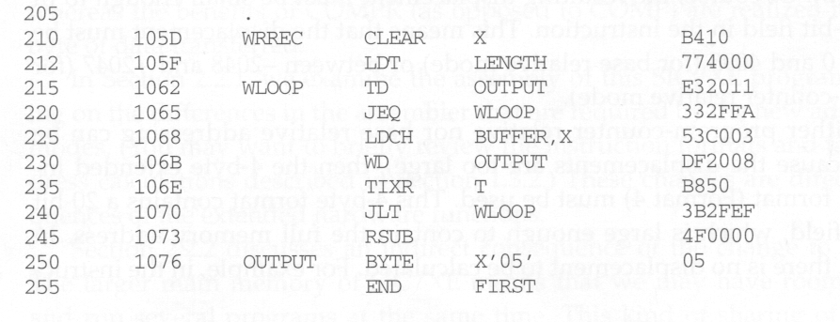
Original Program (2)

Slide 8
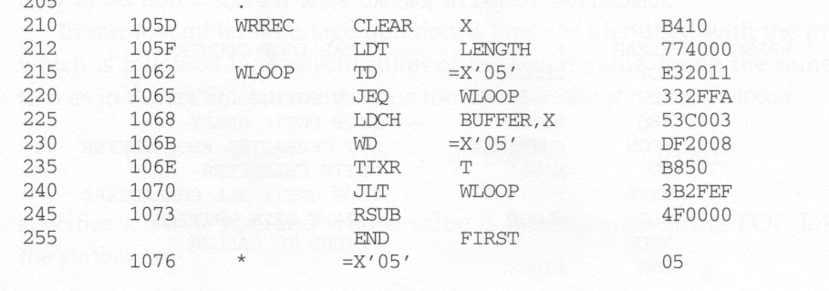
Literal Program (2)’s Object Code
Notice that the object code is the same as the previous one.

Slide 9
Difference between Literal and Immediate Operand
Immediate addressing
  The operand value is assembled as part of the machine instruction.
Literal
  The assembler generates the specified value as a constant at some other memory location.
  The address of this generated constant is used as the target address for the machine instruction.
  The effect of using a literal is exactly the same as if the programming had defined the constant explicitly and used the label assigned to the constant as the instruction operand.

Slide 10
Literal Pool
All of the literal operands used in the program are gathered together into one or more literal pools.
Normally literals are placed into a pool at the end of the program.
Sometimes, it is desirable to place literals into a pool at some other location in the object program.
  LTORG directive is introduced for this purpose.
  When the assembler encounters a LTORG, it creates a pool that contains all of the literals used since the previous LTORG.

Slide 11
LTORG Example
If we do not use a LTORG on line 93, the literal =C’EOF’ will be placed at the end of the program.
This operand will then begin at address 1073 and be too far away from the instruction that uses it. PC-relative addressing mode cannot be used.
LTORG thus is used when we want to keep the literal operands close to the instruction that uses it.

Slide 12
Duplicate Literals
Duplicate literals – the same literal used in more than one place in the program
For duplicate literals, we should store only one copy of the specified data value to save space.
Most assembler can recognize duplicate literals.
  E.g., There are two uses of =X’05’ on lines 215 and 230 respectively.
  However, just one copy is generated on line 1076.

Slide 13
Recognize Duplicate Literals
Comparing the character string defining them
  For example, =X’05’ and =X’05’
Comparing the generated data value
  For example, =C’EOF’ and =X’454F46’
  More intelligent
  However, usually the benefit is not great enough to justify the added complexity.

Slide 14
The Problem with String-Defining Literals
We should be careful about the literal whose value depends on their locations in the program.
E.g., ( * usually denotes the current value of the location counter)
BASE *
LDB =*
If * appears on line 13, it would specify 0003. If it appears on line 55, it would specify an operand with value 0020.

Slide 15
Literal Processing (1)
Need a literal table LITTAB. For each literal used, the table contains:
  Literal name
  The operand value and length
  The address assigned to the operand when it is placed in a literal pool.

Slide 16
Literal Processing (2)
Pass 1:
  When encountering an literal, try to find it in LITTAB. If it can be found, do nothing.
  Otherwise, the literal is added to the LITTAB
    Name, operand value and length can be entered now
    Only the address field is left blank.
  When encountering a LTORG or the end of the program, the assembler makes a scan of LITTAB. At this time, each literal currently in this table is assigned an address. The location counter then should be updated to reflect the number of bytes occupied by each literal.

Slide 17
Literal Processing (3)
Pass 2:
  For each literal operand encountered, we search it in LITTAB and find its assigned address.
  The data values specified by the literals in each literal pool are inserted at the appropriate places in the object program exactly as if these values had been generated by BYTE or WORD statements.
  If a literal represents an address in the program (e.g., a location counter value), the assembler must also generate the Modification record.

Slide 18
Symbols
We can use the EQU directive to define a symbol’s value.
  So far, the only symbols defined in a program are labels, whose values are the addresses assigned to them.
  E.g., MAXLEN EQU 4096.
The value assigned to a symbol may be a constant, or any expression involving constants and previously defined symbols.

Slide 19
Usages of Symbols (1)
Establish symbolic names to improve readability in place of numeric values.
  E.g., +LDT #4096 can be changed to :
  MAXLEN EQU 4096
  +LDT #MAXLEN
When the assembler encounters the EQU statement, it enters MAXLEN into SYMTAB (with value 4096).
During assembly of the LDT instruction, the assembler searches SYMTAB for the symbol MAXLEN, using its value as the operand in the instruction.

Slide 20
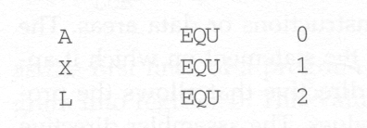
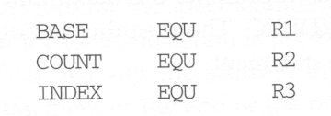
Usages of Symbols (2)
Define mnemonic names for registers:
(1)
(2)

Slide 21

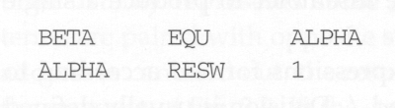
No Forward Reference Allowed
For EQU , all symbols used on the right hand side of the statement must have been defined previously in the program.
This is because in the two-pass assembler, we require that all symbols must be defined in pass 1.
Allowed
Not allowed

Slide 22
ORG
is a assembler directive
allows the assembler to reset PC to values
  Syntax: ORG value
when ORG is encountered , the assembler resets its LOCCTR to the specified value.
ORG will affect the values of all labels defined until next ORG.
if previous value of LOCCTR can be automatically remembered, we can return to normal use of LOCCTR by simply writing ORG.
while using ORG, forward reference is not allowed.

Slide 23
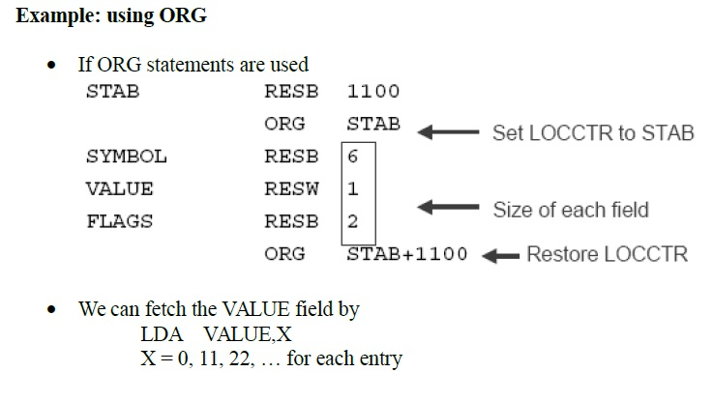
ORG

Slide 24
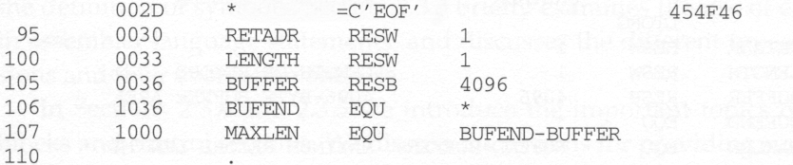
Expression
So far, when we define the value of a symbol or label, only one term is used.
  E.g., 106 BUFEND EQU *
Actually, we can also use expressions which contains many terms to define a symbol’s value.
  E.g., 107 MAXLEN EQU BUFEND - BUFFER

Slide 25
Relative v.s. Absolute Value
Generally, +, -, *, /, operations are allowed to be used in an expression.
Division is defined to produce an integer.
Regarding program relocation, a symbol’s value can be classified as
  Relative
    Its value is relative to the beginning of the object program, and thus its value is dependent of program location.
    E.g., labels or reference to location counter (*)
  Absolute
    Its value is independent of program location
    E.g., a constant.

Slide 26
Relative v.s. Absolute Expression
Depending on the type of value they produce, expressions are classified as:
  Absolute
    An expression that contains only absolute terms, or
    An expression that contains relative terms but the relative terms occur in pairs and the terms in each pair have opposite signs. (/ and * operations are not allowed)
  Relative
    An expression in which all relative terms except one can be paired and the remaining unpaired term must have a positive sign. (/ and * operations are not allowed)

Slide 27
Absolute Expression Example
107 MAXLEN EQU BUFEND – BUFFER
Although BUFEND and BUFFER are relative terms (because their values will change when the program is loaded into a different place in memory), the expression (BUFEND – BUFFER) is an absolute expression.
Why? the value of this expression is 0x1000, which is the same no matter where this program is loaded.
Why? Because BUFEND and BUFFER can be represented as (startingaddr + x) and (startingaddr + y), BUFEND – BUFFER becomes (x – y), which is a constant.

Slide 28
Illegal Expressions
BUFEND + BUFFER
100 – BUFFER
3 * BUFFER
These expressions represent neither absolute nor location within the program
Therefore, these expression are considered illegal.

Slide 29
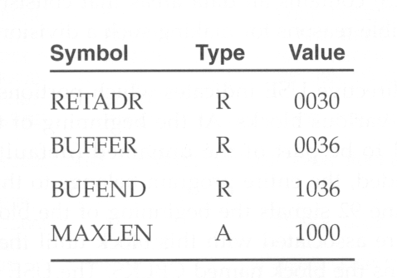
Enhanced Symbol Table
To determine the type of an expression, we must keep track of the types of all symbols defined in the program,
Therefore, we need a flag in the symbol table to indicate type of value (absolute or relative) in addition to the value itself.

